Slide 1


TURK AI Python Developer Task

Slide 2





API
Container A (Producer)
Container C
Container B (Consumer)

Slide 3

LIMIT 160 notices results per query
DA
50
A
SOLUTION Regex and concurrency
DB
50
B
DC
50
250
C
DD
50
D
250
DE
50
.
name
.
Break Point (If finished)
.
.
.
.
.
DZ
.
Z

Slide 4
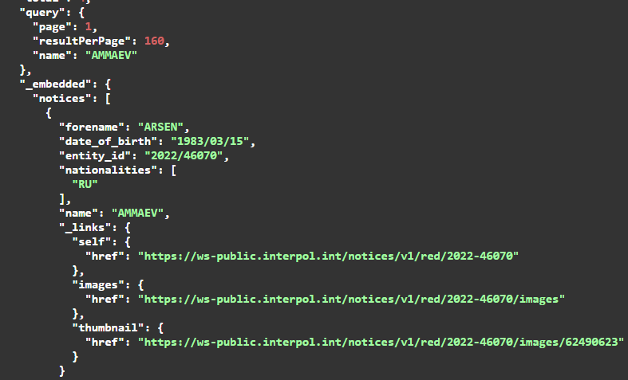
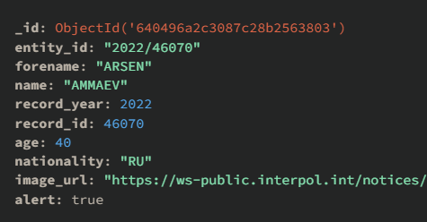
Transform and Upload
API
Sort indexes
NOTE Alert reset every API request session

Slide 5
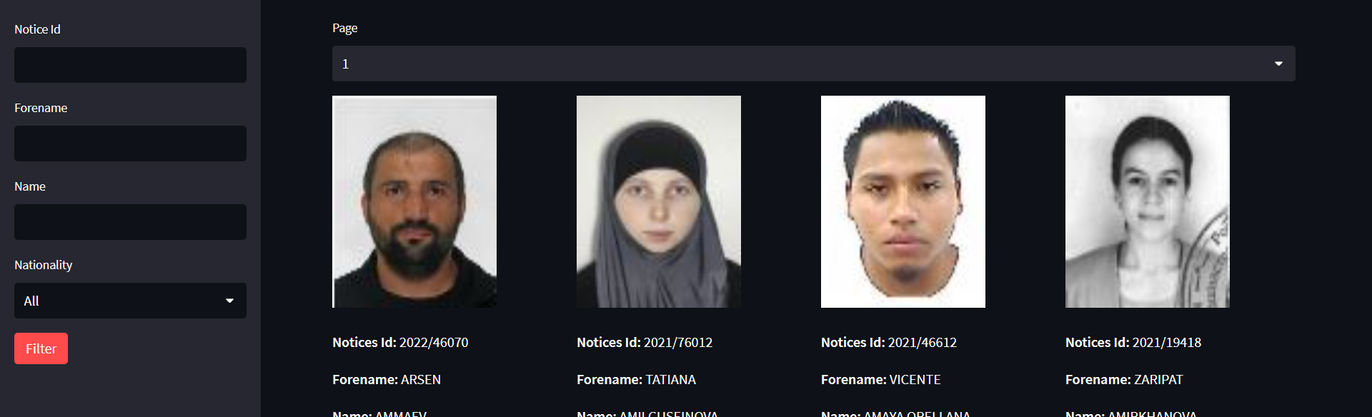

I thought it would be wise to split the searched contacts into pages, as displaying too many searched contacts at the same time causes problems with both performance and request submission.
Thanks to Streamlit, user inputs can be taken from the boxes on the sidebar.
With these inputs, a query is made on the database and filtering is performed.
In this way, it was possible to easily filter and display alerts and non-alerts.
By providing a display with 4 separate columns, I provided easier navigation.

Slide 6
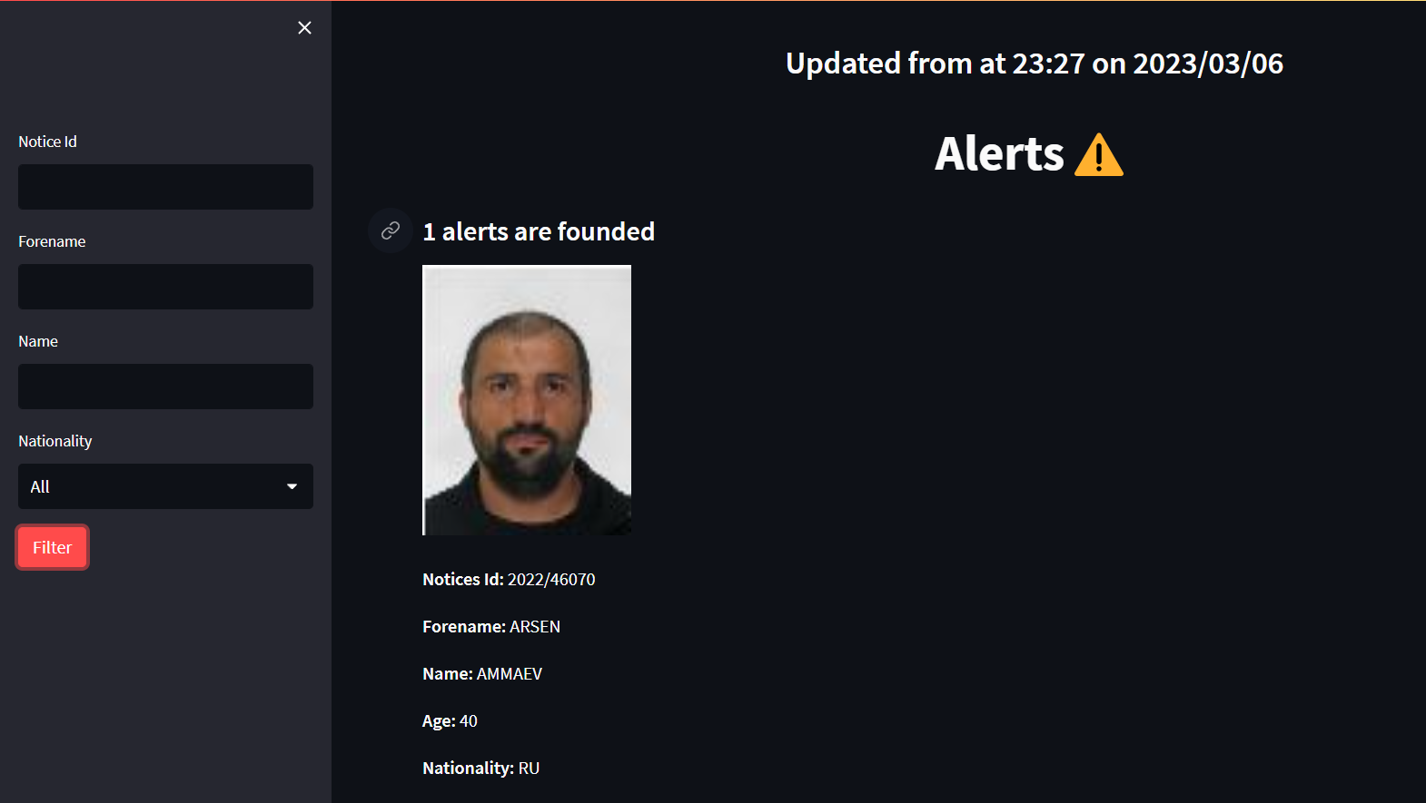
Data taken from Container A for every API request session
Notices results which their alert field is true in MongoDB databases

Slide 7

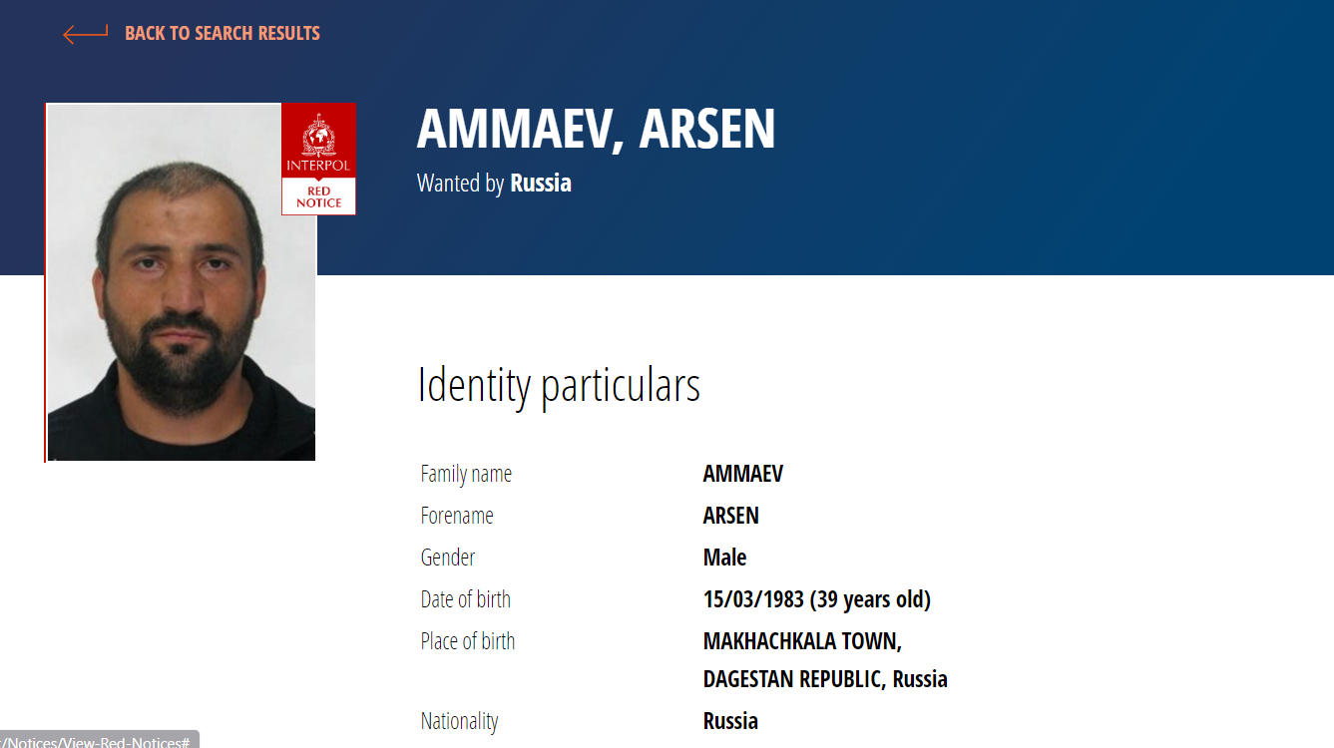
When you click on the picture of the person on the website I made, you will be directed to the relevant page for the searched person.
In this way, more detailed information about the filtered persons can be learnt

Slide 8
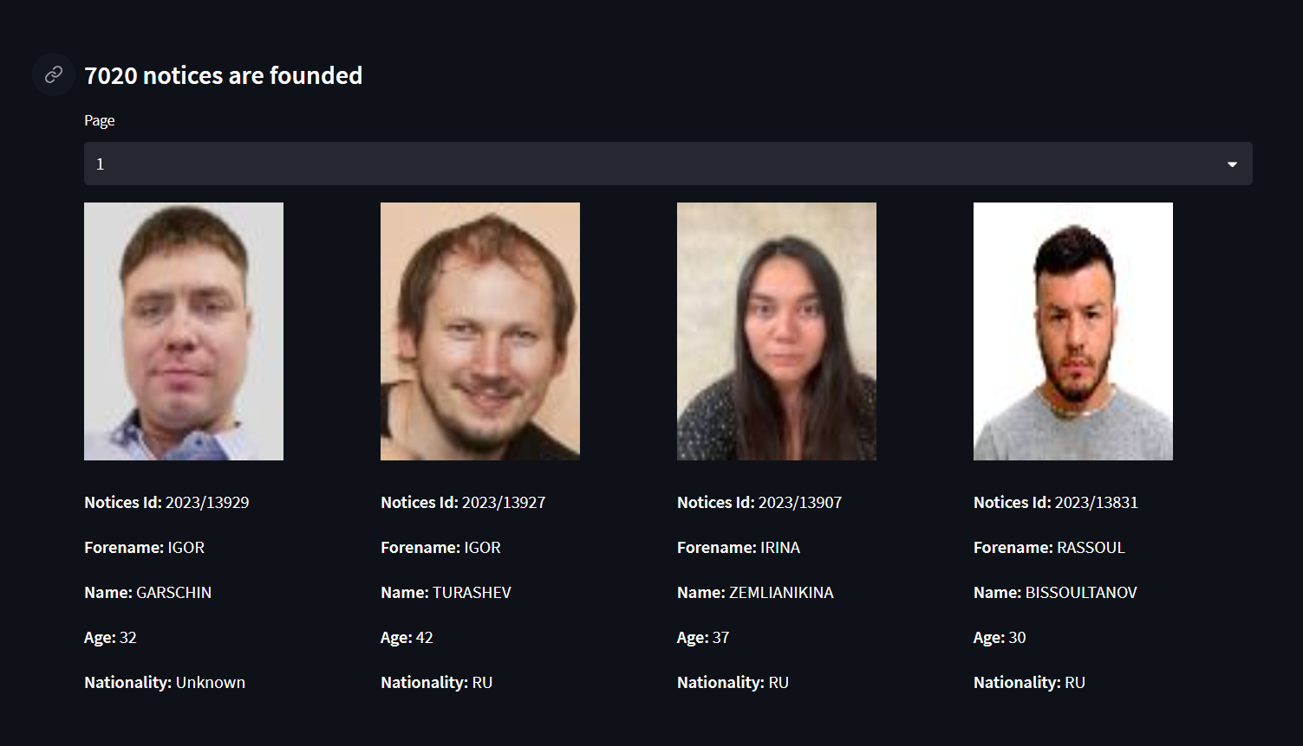
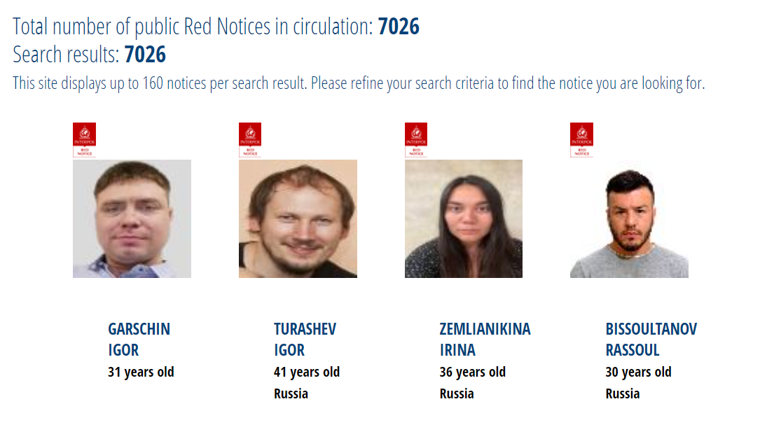
By sorting, results close to the original website were obtained.
The original database is actually not that good. I noticed a lot of errors such as duplicate records, missing records, records with missing information.

Slide 9

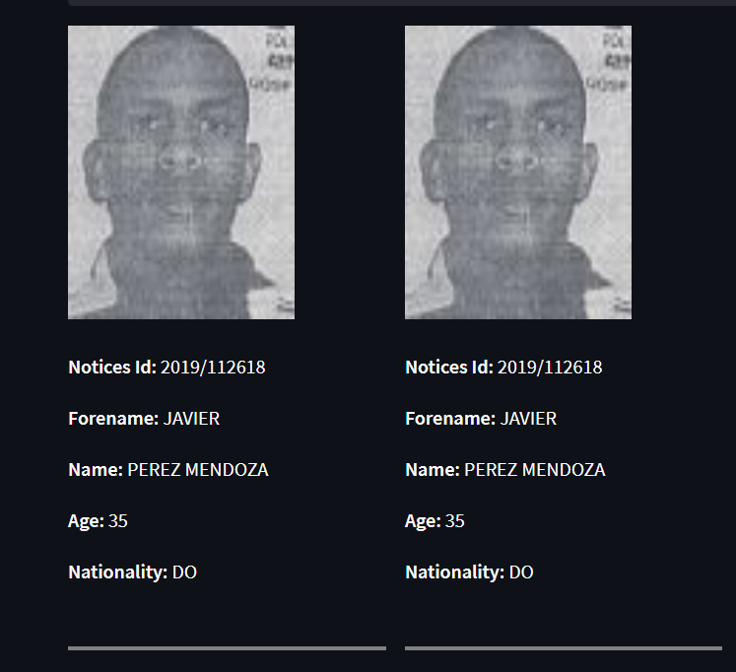
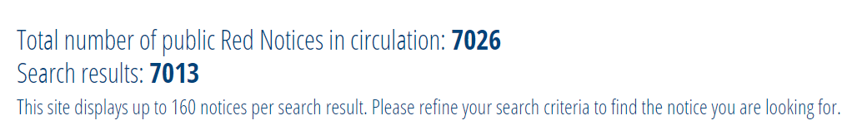
Wrong or Incorrect Records
As a result, although it seems like I didn't get all the results because of the errors in the database, I was actually able to cover all the results.
Regex search result with “^.” for forename

Slide 10

THANK YOU FOR LISTENING ANY QUESTION?

